Slide 1
Zigbee Basic
2019

Slide 2
Agenda
What’s Zigbee?
Protocol Overview
Physical Layer
MAC Layer
Network Layer
Application Support Layer
Application Layer
Q & A

Slide 3
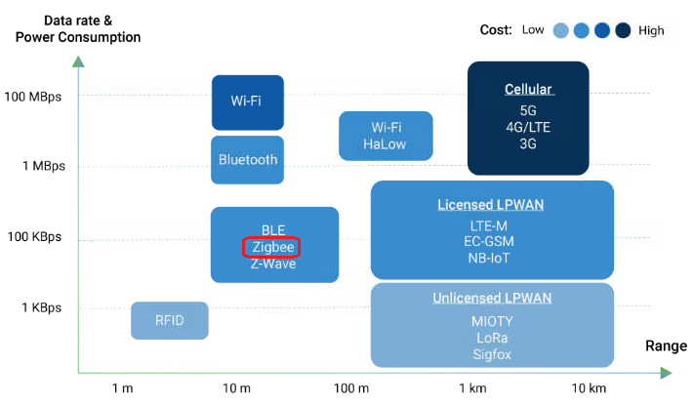
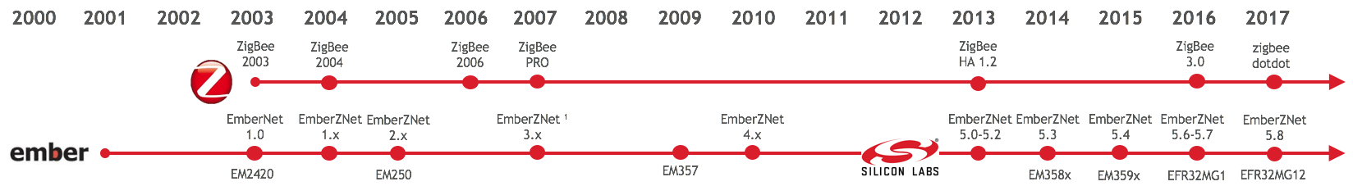
What is Zigbee?
Short Range (10 ~ 100)
Low Data Rate (max=250kbps)
Low Power (can be less than 5uA)
Mesh Topology (Maximum 65535 nodes)
Open Standard (Zigbee Alliance)
Zigbee Specification
Zigbee BDB Specification
Zigbee Cluster Library
Notes:
WPAN VS. LPWAN
Zigbee is a short range, low data rate, load power, wireless mesh technology

Slide 4
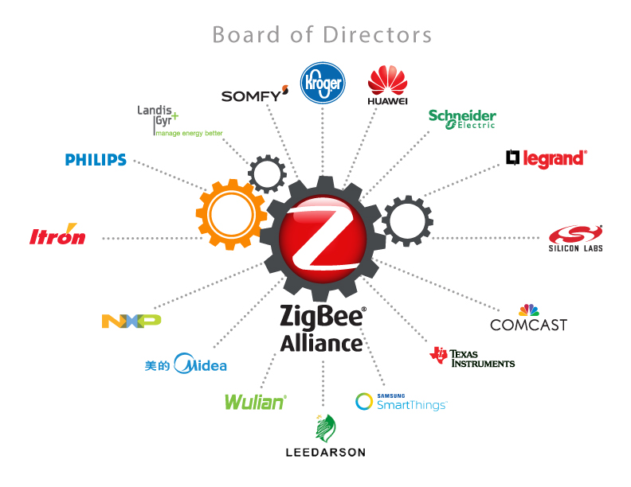
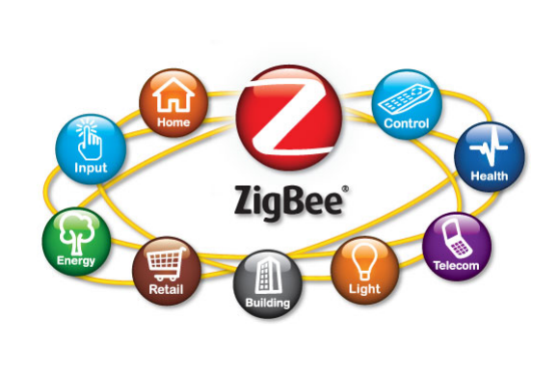

The Zigbee Alliance
Zigbee 3.0
Unification of Zigbee profiles (except Smart Energy and RF4CE)
Enhanced networking and security
Backwards compatible
Mandated since May 2017
3.0
Notes:
Zigbee standard is defined by Zigbee Alliance.
Silicon Labs is member of the promoter.
Pre Zigbee 3.0: there are many device profiles targeted for different market.
All unified in Zigbee 3.0 since 2016.

Slide 5
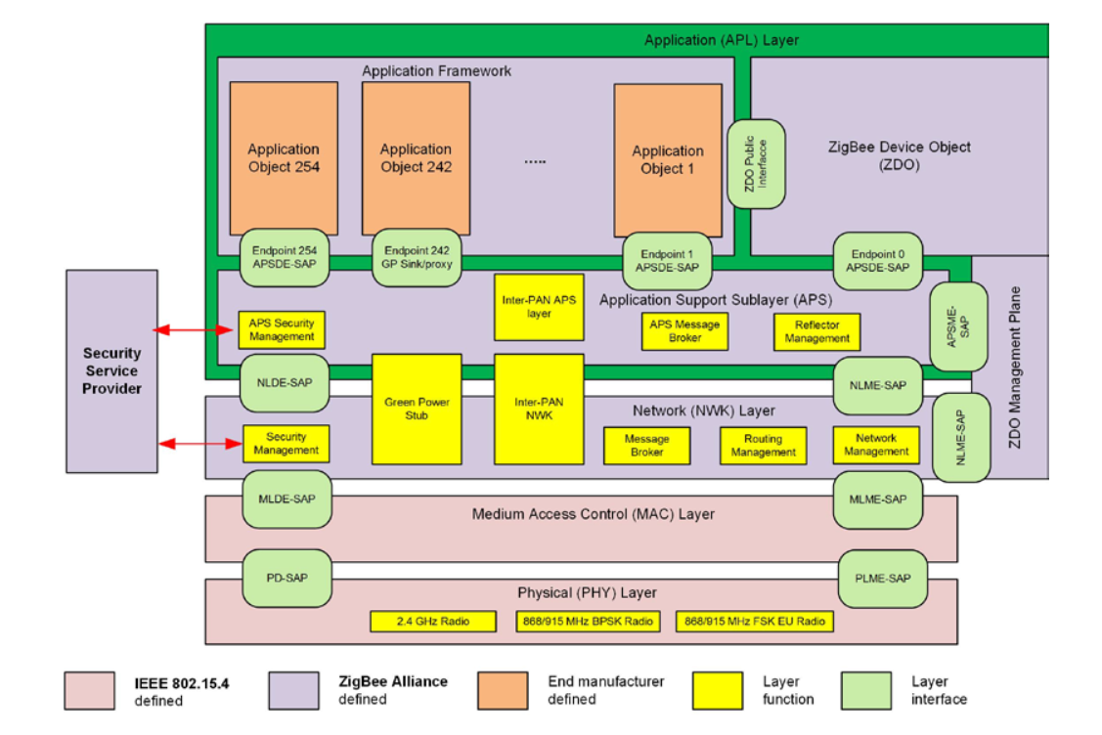
Overview
802.15.4 spec
www.zigbee.org
UG103 series

Slide 6
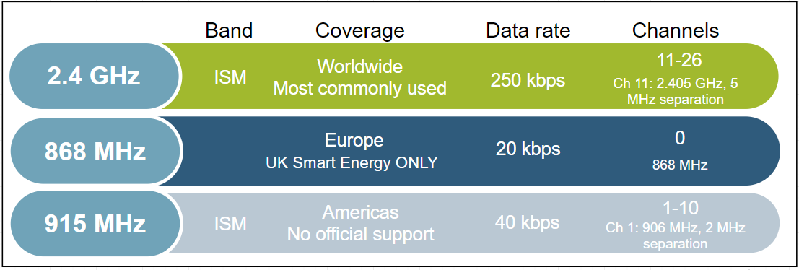
Physical Layer
Interface between physical radio and MAC layer
Radio On/ Off
Modulation / Demodulation
Channel selection
Link quality estimation
Energy detection
Range ~ 2 km line of sight
Notes:
Physical layer handles the transmission and reception of raw bits of data.
The PHY layer uses binary phase shift keying (BPSK) in the 868/915 MHz bands and offset quadrature phase shift keying (O-QPSK) at 2.4 GHz. The information is coded onto the carrier with direct sequence spread spectrum (DSSS), an inherently robust method of improving multipath performance and receiver sensitivity through signal processing gain. Note that 2.4 GHz is the most commonly used frequency band for Zigbee communication worldwide. The only official sub GHz support is for UK smart energy.
Output power:
802.15.4 is designed for low power, low data rate networks with a low-cost objective in mind. These are generally referred to as PANs or Personal Area Networks. The idea here is that these would be low to moderate radio range application designs. But amplification is also possible. It is possible to get up to roughly +20 dBm output power in most countries. In Europe it is regulated a little bit lower to around +10 dBm. But, that's enough to get you anywhere from about one to three kilometers, depending on what your link budget is and what kind of amplification you have and/or what kind of antenna you have.
Data rate:
The raw bit rate is 250 kilobits per second using the 2.4 GHz direct sequence spread spectrum Phy or DSSS. In the real world you are going to see about a quarter or fifth of that. The expected throughout is comparable to a 56k baud modem. Around 52700 kilobits per second on a single hop link. Once you put in multi-hop effects, things will take a little bit longer to propagate.
Open field range
With 2.4 GHz PHY, the ranges we mentioned could be roughly two kilometers with line of sight. This is with a fair amount of amplification and still within legal limits in most areas. And because of all the channels, you have robust communications such that you can avoid interference by making sure to pick channels that are not terribly noisy. Now if you do pick a channel and it becomes noisy, ZigBee has a high level response with what they call "frequency agility." So that some network manager can move the network to a different channel. The other advantage to the 2.4 GHz spectrum is that it's available globally which means you have a wide range install base for your product.

Slide 7
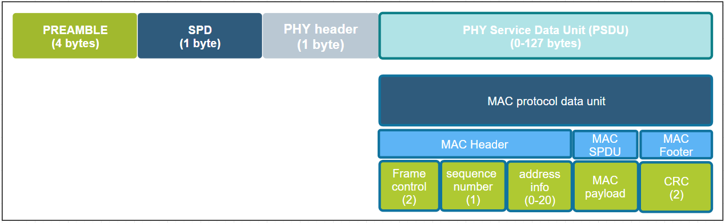
MAC Layer
Takes care of 1 hop communication and acknowledgements
Verifies integrity of packet using CRC
Uses data from the physical layer to sense activity and randomize message transmission (CSMA – CA)
4 MAC Frames
Beacon
Data
ACK
MAC Command
Notes:
We will be moving on to the MAC layer now.
The main function of the MAC layer is to ensure reliable one-hop message delivery by verifying the checksum and sending one-hop acknowledgements. The MAC PDU is shown in the picture. Here are some more details on these functions.
CSMA CA
802.15.4 allows for multiple networks to be on the same channel. Therefore there needs to be some way to avoid having packets from different networks collide over the air and cause errors in communication. MAC sub-layer controls access to the radio using CSMA-CA (Carrier sense multiple access with Collision avoidance). Collision avoidance is done by CCA (Clear Channel Assessment). Before transmitting, every node shall check to see if the airwaves are clear (RSSI below CCA threshold). If they are, the node shall go ahead and transmit after a small random backoff. If the CCA does not pass, then the node shall wait a number of back off periods before trying the process again. The random backoff allows multiple nodes to stagger transmissions so at some point they can find clear air to transmit. Although the bit rate is low, since packets are small (128 bytes), each node completes its transmission successfully even if the channel is fairly busy.
Acknowledgements:
MAC layer also provides a method for nodes to know that 1 hop unicast transmission have been successfully received by way of acknowledgements and that the integrity of the transmitted message has been preserved by verifying a CRC.
Multi hop transmissions shall be acknowledged on every hop. After the node performs the CCA check and transmits the message, it waits for a MAC acknowledgment. If it does not receive one, the node shall attempt to resend the message multiple times until it eventually succeeds, or the maximum retries have been exhausted. The Silabs Ember ZNet stack provides additional mac retries providing earlier corrective action for a failed message transmission instead of waiting until an end-end retry to kick in, which could take several seconds.

Slide 8
Network Layer
Basic Concepts
Device Type
Network Address
PAN ID
Extend PAN ID
Device Address
Node ID
Eui64
Network Activities
Form/Join/Rejoin/Leave
Address Assignment
Node ID Conflict
PAN ID Conflict
Transmission/Reception
Neighbor and Routing
End Device Aging
Persistent Data
Network Security
Message authentication
Encryption
Replay Attack Protect
Network Key Update

Slide 9
Device Type
Device Type
Coordinator
Router
End Device
Sleepy
End Device
Zigbee
FFD
Full Function Device
RFD
Reduced Function Device
IEEE-802.15.4
ZigBee Coordinator | ZigBee Router | ZigBee End Device
There can be only ONE! | Message routing | Leaf nodes
Always 0x0000 | Can also serve as end devices | Can be sleepy devices
Trust Center, Network Manager | Cannot be sleepy | Has parent
Acts as Router | Lives with the network | Parent responsibility
ZC
ZR
ZED

Slide 10
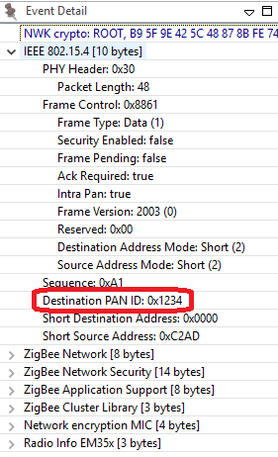
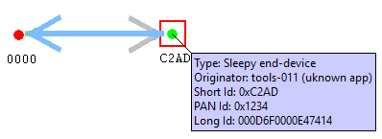
Addressing in Zigbee: PAN ID
PAN ID – Personal Area Network Identifier
Identifies the network
MAC layer filters messages meant for the network
Coordinator picks a random value
Should be unique but conflicts can happen
Stack resolves conflicts -> xPAN ID
Notes:
The PAN, or Personal Area Network, is separated from other networks through its PAN ID. This is a 16-bit identifier that all nodes in the same PAN will share. So it’s something akin to a subnet mask in the Ethernet world in that you generally would only be communicating with devices within your local network, which is the PAN in this case. This identifier is placed into the low-level MAC-layer header in every out-going packet, and it allows devices that receive the packet to filter out the messages that don’t pertain to their network. They can compare it against their own PAN ID, and decide if this is a message from someone in their own network, or if it’s from someone in a different network that just happens to be on this channel so there’s no need to try to decode or decrypt it.
The PAN ID is chosen by the coordinator upon network formation. Because the PAN ID is the distinguishing factor between one network and another, it should be random to unsure its uniqueness. It’s recommended that you select a random 16-bit value for your PAN ID that keeps your network from coinciding with any other network that happens to exist in the area.
Now, what if you happened to pick a PAN ID that’s already used by another network? Or what if you did pick a random PAN ID that wasn’t in conflict with any other network, but later another network grew to overlap with yours? If the PAN ID conflict ever happens, the stack can in fact detect such a conflict and can update its PAN ID automatically and inform all the nodes in its network to move to the new PAN ID, so that each node can continue communicating with nodes in its original network and exclude anyone on the conflicting network. You may be wondering how the stack does this.

Slide 11
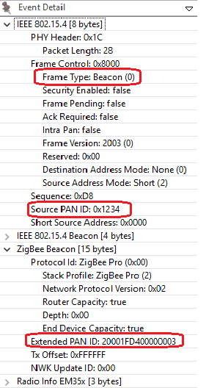
Addressing in Zigbee: Extended PAN ID
Extended PAN ID
Unique per PAN
64bit ID
known to all nodes in the PAN
Randomly generated by Coordinator at time of network formation
Only sent over-the-air in response to active scan.
Enhances network selection
PAN ID changed? Still recognize the network
Conflict results in unusable network
Notes:
Well, it is done through the use of the extended PAN ID, which is another network identifier known by all nodes in the PAN.
While the normal short 16-bit PAN ID is transmitted over the air in all the packets because it’s short and simple, the 64-bit extended PAN ID is rarely transmitted over the air. The extended PAN ID is also unique for every PAN, and it’s basically used as a backup criteria when the 16-bit PAN ID is not enough to always distinguish one network from another. For instance, when a PAN ID conflict occurs and you want to notify all devices in your network to move, the way that you distinguish your network from the conflicting network is, those devices in your network all share the same extended PAN ID. The extended PAN ID is highly unlikely to ever conflict because it has 64 bits compared to the 16 bits in the short PAN ID.
The extended PAN ID is also chosen by the coordinator during network formation. It’s only sent over the air in response to an Active Scan when nodes are soliciting the network, or when a PAN ID update is occurring.
It’s also a useful factor in allowing you to select the network. If you are trying to come into a network rather than form one, you might wonder how to tell which networks are available. The way the networks are distinguishable from one another is not only in the PAN ID but also in the extended PAN ID. You might want to do something special where you decide you are only going to use a certain subset of extended PAN IDs so that you can distinguish your networks from other networks, but just don’t limit yourself too much, because the more you limit this the more likely that you have a conflict, and if your extended PAN ID ever conflicts there’s really nothing you can do to fix that. It’s a little like a WiFi SSID, except that those can be the same between networks and this one can’t.

Slide 12

Addressing in Zigbee: Node ID
EUI – 64 address aka LongID / IEEE address
Assigned during manufacturing
Should be unique in the world.
IEEE assigns ID ranges to companies
Standardized to 64 bits
Can be changed at the cost of loosing uniqueness
Example ID
Network Address aka. Short ID/Node ID
Randomly chosen during runtime.
Can be conflicting
Resolution based on LongID
Size 16bits
Should be unique in the network to avoid conflicts
Example ID
Notes:
Besides their network-wide criteria, one node is distinguished from another by its individual node addresses.
A node has a short address and a long address. The long address is the IEEE-assigned MAC address, or EUI-64. It is a 64-bit address that is globally unique, meaning no two IEEE-based radios in the world should ever have the same EUI-64. This is generally assigned at manufacturing time. They are assigned when the chips come out of our manufacturing facility before they arrive to you, and they will never change. That’s how you tell one radio from another. But because 64 bits are a lot of data, this long address is not sent over the air very often.
Most of the time the much shorter, 16-bit address is used over the air. This is known as the node ID and unique within a network, similar to an IP address in Ethernet world. It is assigned as the node enters the network, and it’s supposed to be unique within that network. There may be two networks each of which has a node with the same node ID, but because they in different PANs, it doesn’t matter.
Note that it’s possible for two nodes to have chosen the same random node ID when they enter the network. If that happens, much like the PAN ID scheme, there is a method for conflict resolution. When the nodes notice the conflict, based on the EUI-64 information as a fallback, they can agree upon new addresses. So the nodes can change addresses at run-time if required, based on a conflict.
In addition to addresses of the node, there are also concepts of addresses within the node these are Endpoints and Clusters and they are explained in the “Clusters Endpoints Devices” training module.

Slide 13
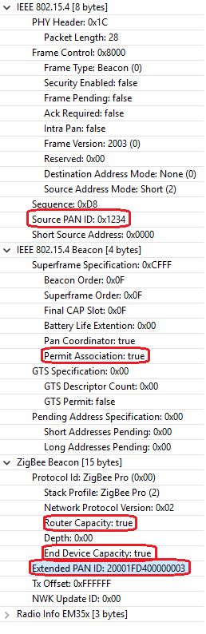
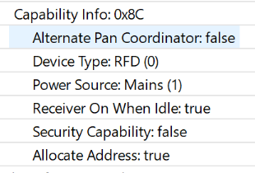
Forming and Joining a Network
Coordinator
Device
Four parameters of a network
PAN ID
Extend PAN ID
Channel
Tx Power
Form network
Send beacon request on every channel to find joinable networks
Beacon request
Beacon
Might receive multiple beacons
Choose the one with best RSSI
Association request
Association response
Got node ID
Transport NWK key
13

Slide 14
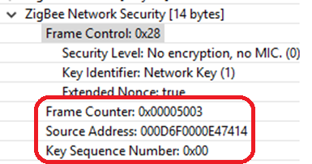
Network Layer Security
Symmetric Encryption/Decryption
All devices use the same key
Message Integrity Check
Replay Attack Protect
NWK Key Management
Unsecured
SYNC
PHY
HDR
MACHDR
NWKHDR
NWK Payload
Application of security suite adds auxiliary header and also an integrity code
Secured
SYNC
PHY
HDR
MACHDR
NWKHDR
Auxiliary
HDR
Encrypted NWK Payload
MIC
All the above NWK frame is integrity-protected

Slide 15
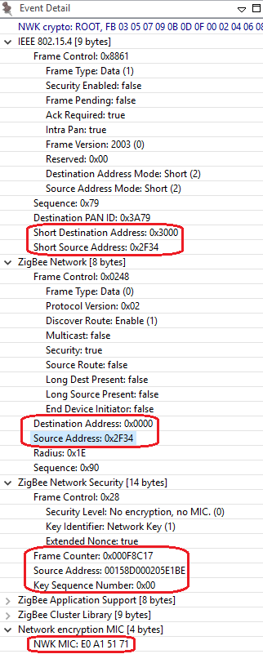
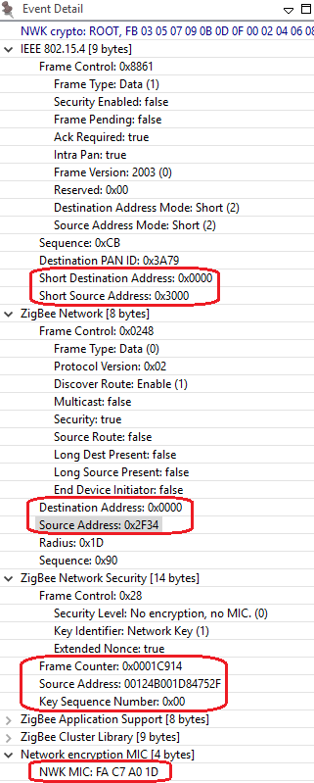
Network Layer Security – Hop-by-Hop Security
Incoming
0x2F34
00158D000205E1BE
MIC Check
1
Drop
0x3000
00124B001D84752F
Decrypt
2
To me?
0x0000
00124B000CC8983A
Process
Encrypt
Add Auxiliary HDR
Add MIC
1
2
Forward

Slide 16
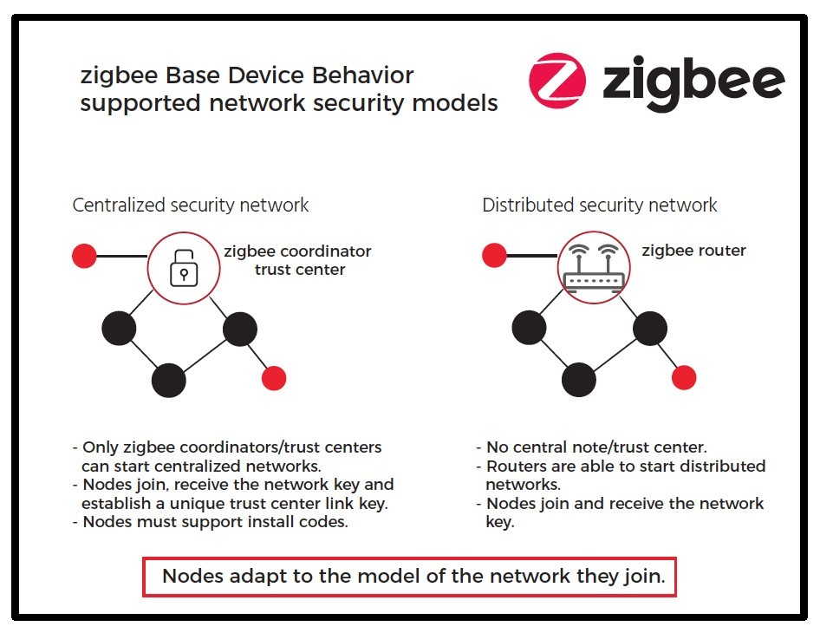
Network Layer Security – NWK Key
NWK key is a 16-byte octecs
Randomly generated when network formed
Trust Center:
a network role who distribute NWK key to new devices
Centralized Security Model:
Only one Trust Center (Coordinator)
Distributed Security Model:
Every router can be Trust Center
NWK key transportation:
Secured in application layer

Slide 17
Network Layer Security – Frame Counter
Node A
Node B
Node C
Transmission side
Outgoing FC needs to increase
Outgoing FC needs to save in non-volatile memory and restore after reset
Reception side:
Need to save all frame counter of neighbors
Node | FC
B | 100
FC=100
Node | FC
B | 100
C | 200
FC=200
FC must be <= 0x80000000
Will wrap after a year if keep transmitting at a rate of 135pps.
NWK key MUST be updated before it wraps.
Node | FC
B | 100
C | 200
FC=100

Slide 18
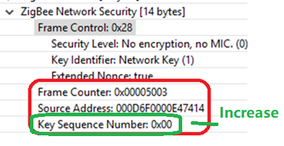
Network Layer Security – NWK Key Update
Trust Center
Device
Trust Center generate a new NWK key
Trust center broadcast the new NWK key to devices
Trust center broadcast a command to notify all devices to switch to the new key
For devices missed the update, they need to perform a rejoin process to get the new key
Generate new key
Broadcast new key
(encrypted by old key)
Save new key
Broadcast key switch command
New key take effect

Slide 19
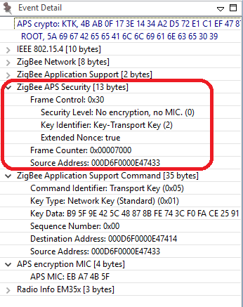
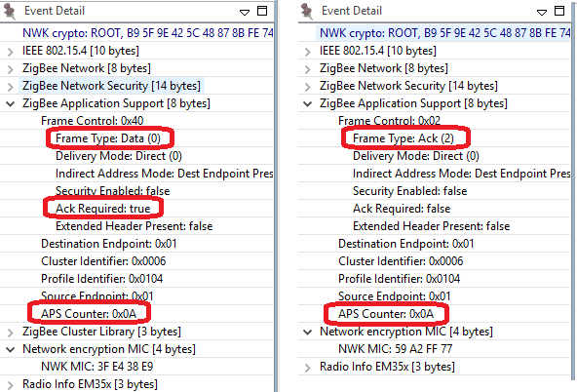
APS Layer Overview
Data transmission
Group / Multicast
End to end retry
Duplicate rejection
Fragmentation
Management
Group management
Security
19

Slide 20
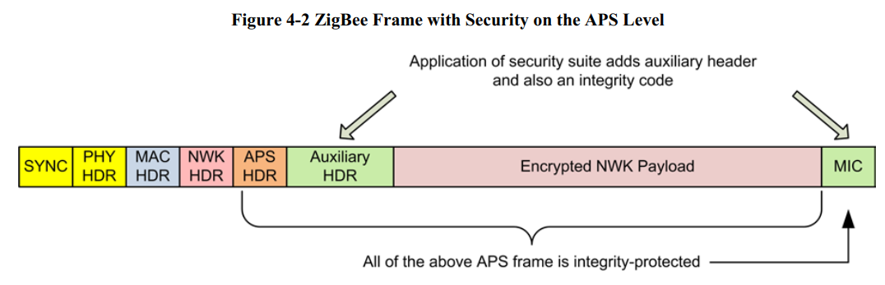
APS Layer Security
End to end security
Link key:
Trust center link key
Application link key – (Used in Smart Energy)
Centralized Model
Default global link key: ZigbeeAlliance09
Install code
Distributed Model
Global link key: will be offered by the Allience
Touch link key: will be offered by the Allience
APS layer security is optional. For non-Smart Energy applications, aps layer security is mainly used to secure the transportation NWK key message

Slide 21
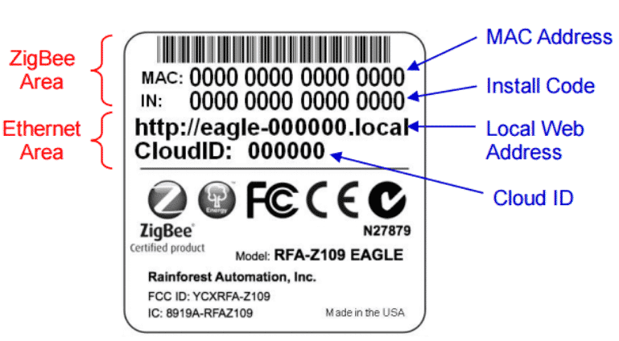
APS Layer Security – Install Code
Factory
Installation
TC link key is derived from install code
Install code is sent out of band.
Install code is mandatory of Zigbee 3.0.
Generate Install code
Program Install code to device
Put a note on the device
Derive TC link key from install code
Configure this link key for this device

Slide 22
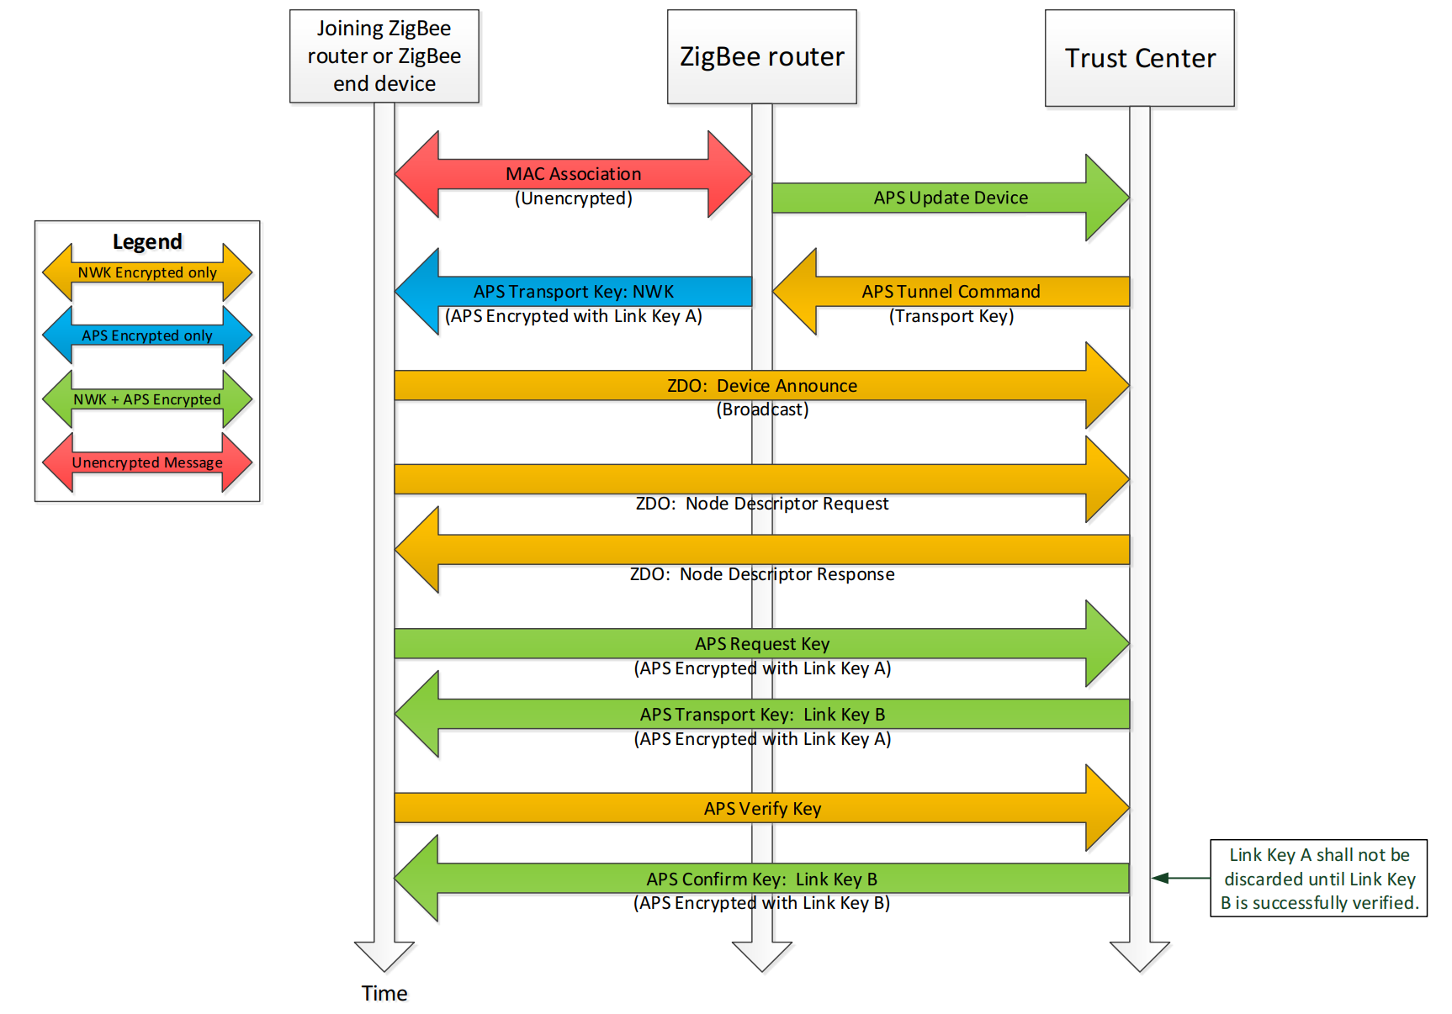
APS Layer Security – Trust Center Link Key Update

Slide 23
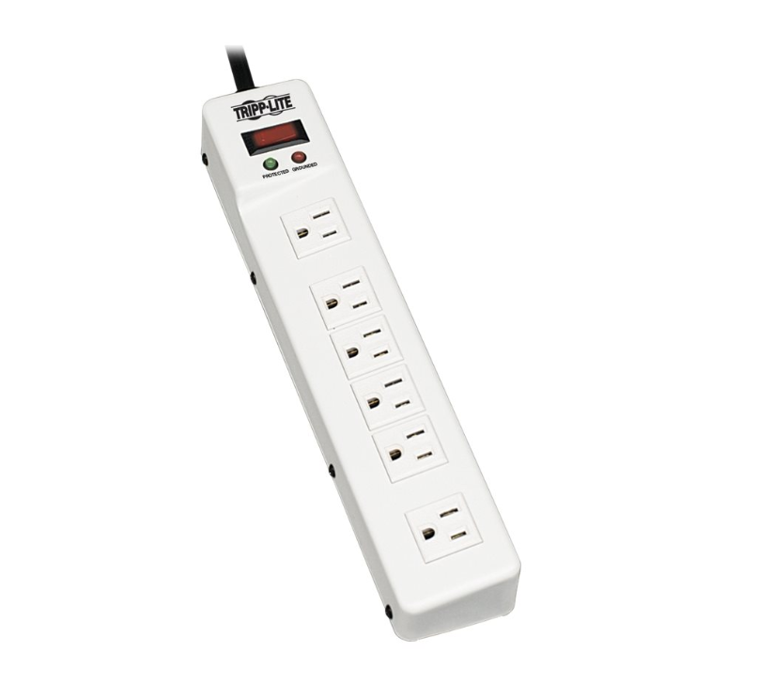
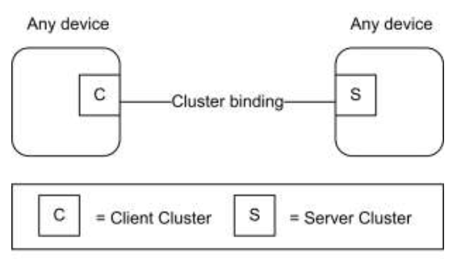
Overview of Application Layer
Endpoint: logical device
Endpoints 1-239 are available for user applications
Endpoints 0, 240-255 are reserved for special functions
Endpoint 0: Zigbee Device Object (ZDO); used for network config/admin
Endpoint 255: Used for Broadcasting a message for all endpoints
Cluster: communication model
Client/Server model
Defined in Zigbee Cluster Library (ZCL)
Cluster ID
Commands
Attributes
Power Strip
Endpoint 1
Endpoint 2
Endpoint 3
Endpoint 4
Endpoint 5
Endpoint 6
23

Slide 24
Example of Cluster
Color Control Light with 2 bulbs
Attribute | Value
On/Off | True/False
Device A
Command | Direction
On | Client to Server
Off | Client to Server
Toggle | Client to Server
Bulb 1
End point 1
Turn on/Turn off
On/Off Cluster
Brightness Control
Level ControlCluster
Color Control
Color Control Cluster
Attribute | Value
Current Level | 0-100
Bulb 2
End point 2
Command | Direction
Move to level | Client to Server
On/Off Cluster
Level ControlCluster
All standard clusters are defined in ZCL spec.
Clusters can be customized
Add new clusters
Add new attributes or commands to standard cluster
Color Control Cluster
24

Slide 25

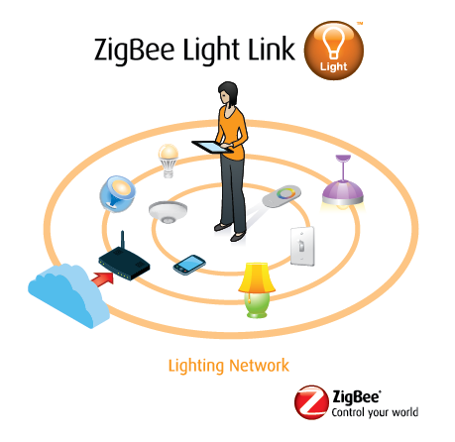
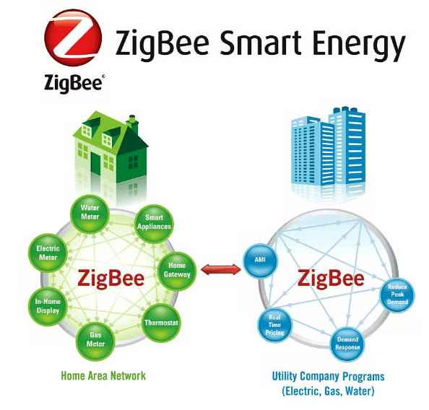
Special Application
25

Slide 26
Q&A
Q&A

Slide 27
Thank you!
Notes:
Thanks

